Slide 1

DATAPROOF
Claim the data a company holds on you — and check they actually gave it all. A consumer-first approach to Data Ethics & AI Governance.

Slide 2




The Problem
The Data Breach Reality: Most people only realize the value of their data when they receive a breach notification
The Request Trap
The Verification Gap
Laws like GDPR and CCPA give you rights, but practice is broken. Most users don't know who to contact, what to ask for, or the correct legal terminology to use.
Even if you get a reply, who checks if it's complete? Companies can quietly leave data out, and today, there is no tool to catch these "gaps and dodges."

Slide 3
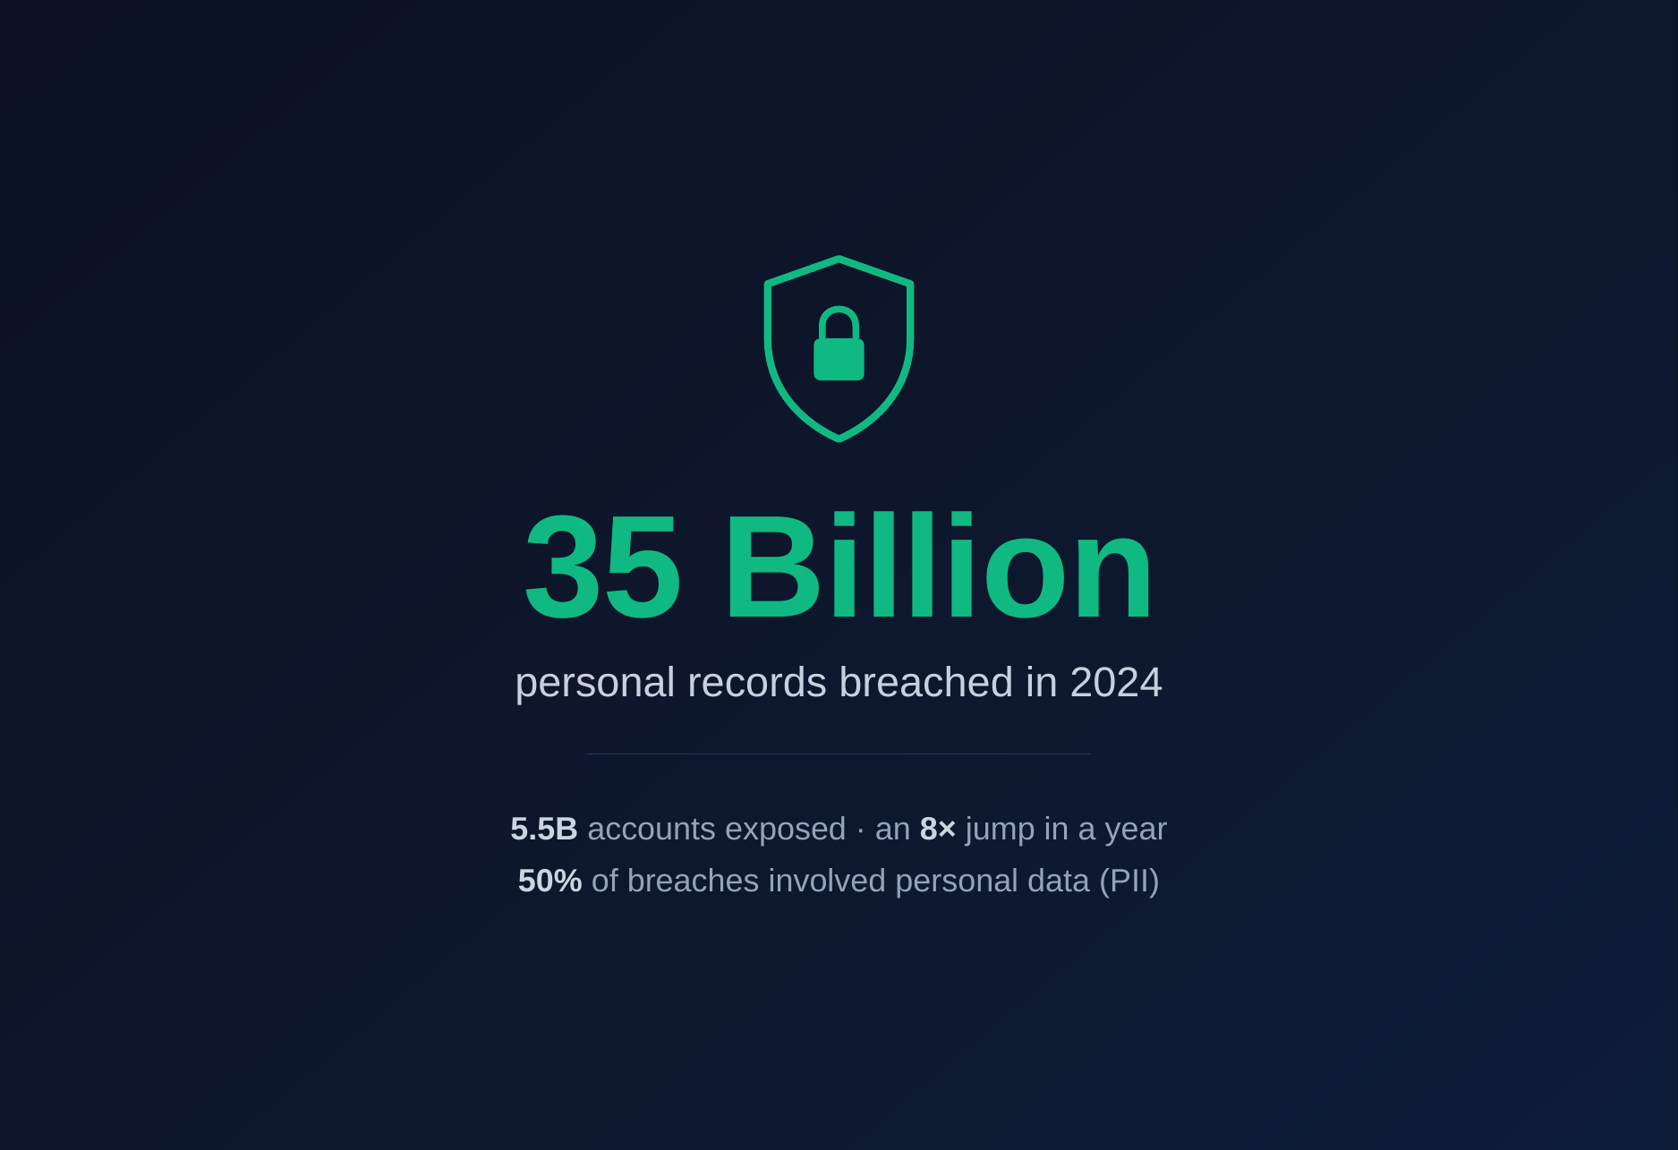


The Growing Crisis
35 Billion Records: Breached in 2024 alone across 9,500 disclosed incidents.
Record Compromise: 5.5 Billion accounts breached, an 8x increase from the previous year.
High Stakes: 50% of breaches involved customer PII (Personal Identifiable Information).
Information Asymmetry: You are told your data is gone, but you can't verify what the company still holds.

Slide 4


Our Solution
DataProof: The Rights Advocate
A simple web app that guides you through the entire data request lifecycle. From finding the right contact to verifying the compliance of their response.
•
Stand on the person's side, not the enterprise.
•
Privacy by design: You stay in control of your data.
•
Plain language explanations of complex legal gaps.

Slide 5






How DataProof Works
1. Pick
2. Know
3. Send
4. Verify
Select the company and your goal: Access or Deletion.
Our app works out which laws apply and what you're owed.
We draft the request in the right legal words for you.
Upload the reply; we check for missing or dodged info.

Slide 6
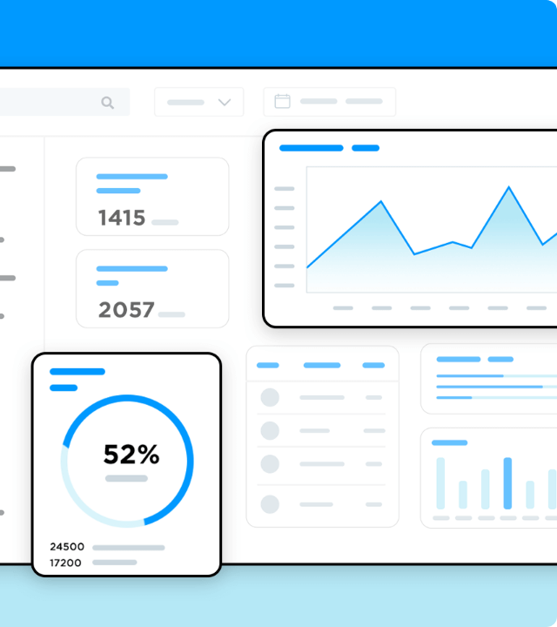
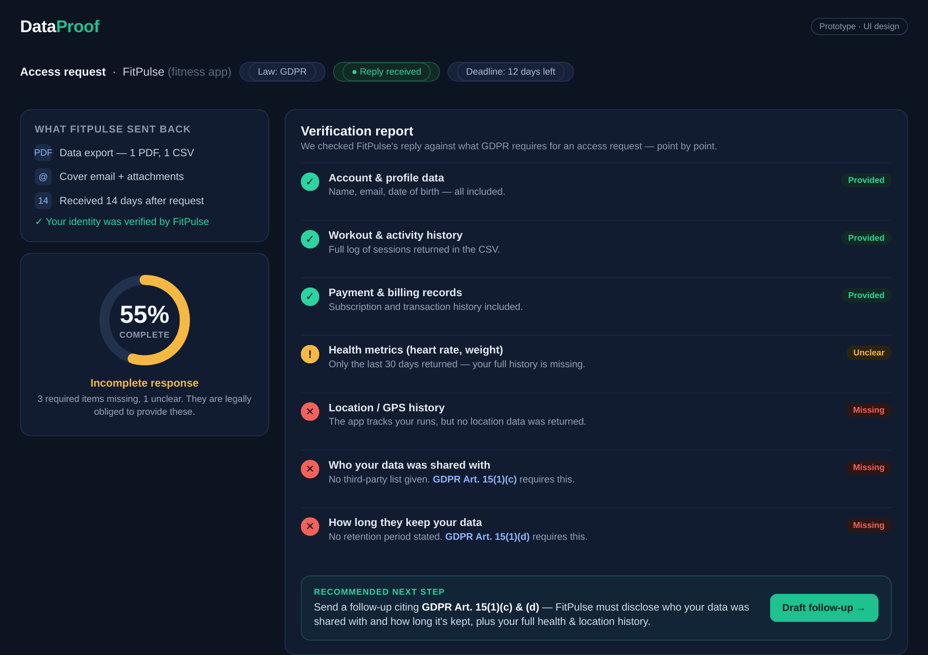
The AI Checker
Key Innovation
Existing tools stop at sending. DataProof keeps going. Our Compliance Engine reads the company's reply and compares it against a legal rules-base.
Using a reasoning LLM, we identify if the company is using template "dodges" or excluding mandatory data categories specified in GDPR/CCPA.

Slide 7
DataProof in Action
An access request to a fitness app, checked point-by-point against what GDPR requires.

Slide 8
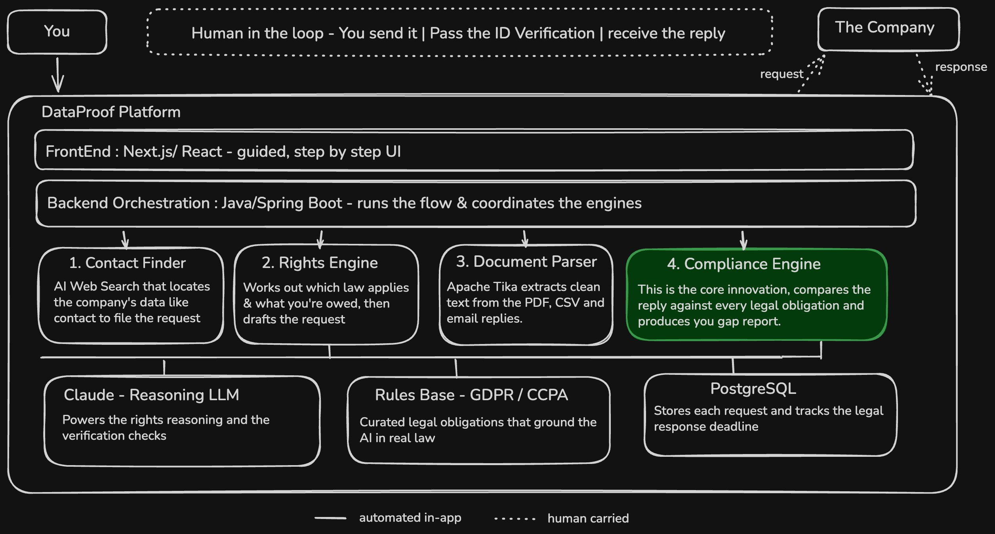



Slide 9
Market Differentiation
Feature | Incogni / DeleteMe | OneTrust / Transcend | DataProof
Target Audience | Data Broker Removal | Enterprise / B2B | End Consumers
Compliance Check | No | Yes (For Firms) | Yes (For People)
Identity Control | Third-party Agency | Internal Platform | User-Direct
Legal Reasoning | Static Templates | Process Automation | Dynamic AI Verification

Slide 10
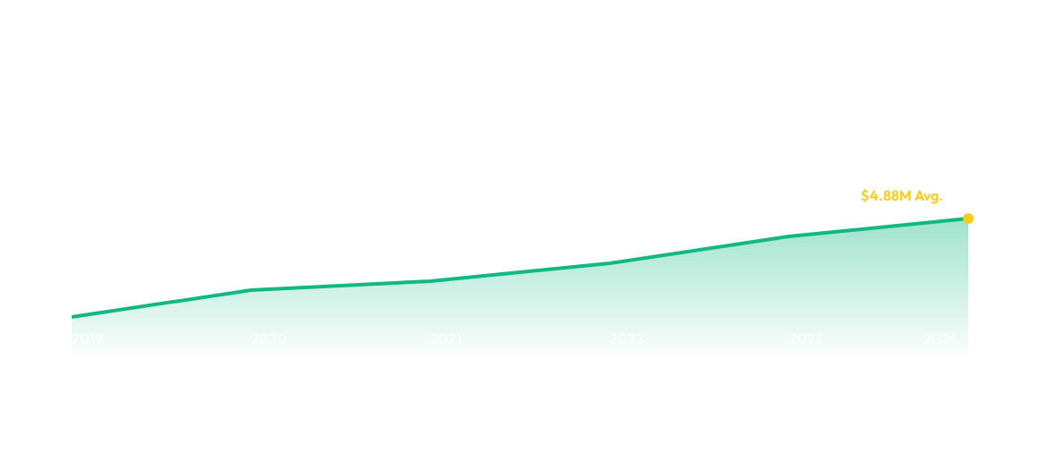
Impact & Trends
Average Cost of a Data Breach (USD Millions) - Highlighting the urgency for consumer-side verification.
As costs and breaches rise, the ability for individuals to verify their data status becomes a fundamental civil right.

Slide 11
Future Potential
Phase 1
Phase 2
Phase 3
Global
GDPR & CCPA core support. AI Compliance Engine V1.
Direct API integrations with major cloud providers for faster access.
Automatic Litigation Support: Flagging violations for law firms.
Support for Brazil's LGPD, India's DPDPA, and more.

Slide 12

QUESTIONS?
DATAPROOF — Personal Data Sovereignty
Governance · Data Ethics · AI
Empowering the person, one verify at a time.

